Slide 1
HNDIT2302 IT Project Management

Slide 2
Project phases and project life cycle
Projects are divided into phases to provide better management control.
A project life cycle is a collection of project phases
Project life cycle serves to define the beginning and end of the project

Slide 3
Project life cycle generally define
No single way to define an ideal project life cycle
Allow PM team to choose the most appropriate life cycle
Various project may have distinct project life cycle
eg :some life cycle have 4 or 5 phases and some have 9 or more

Slide 4
Project life cycle generally define
What technical work to do in each phase (eg in which phase should the architect’s work to be performed)
Who is involved in each phase
How to control and approve it

Slide 5
Project Phases and the Project Life Cycle
Project phases vary by project or industry, but some general phases include
concept
development
implementation
support

Slide 6
Project Life Cycle Example Phases
Concept and Proposal
Development
Implementation
Verification
Termination
Initial Phase
Intermediate Phases
Final Phase

Slide 7
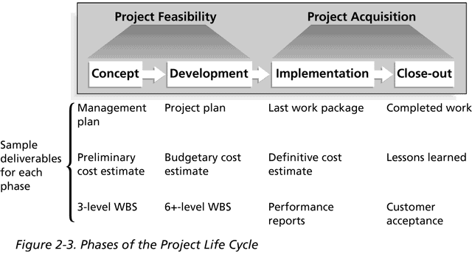
Phases of the Project Life Cycle

Slide 8
Project life cycle and product life cycle
Project life cycle is a part of the product life cycle
Project life cycle identify which transitional actions at end of the project are included or not
Project life cycle goes through a series of phases to create the product
Additional projects can be included to upgrade product
Notes:
Projects are approved only after completion of feasibility study, a preliminary plan or analysis

Slide 9
Popular models of a System Development Life Cycle
Waterfall model
Spiral model
Implemental release model
RAD
Prototype model
These are all examples of product life cycles.

Slide 10
Product Life cycle
Products also have life cycles.
The Systems Development Life Cycle (SDLC) is a framework for describing the phases involved in developing and maintaining information systems
Common name for these general phases are in information systems.
Planning
Analyzing
Designing
Implementation
Support

Slide 11
Project life cycle & Product life cycle
Large system development products are developed as a series of projects.
Project life cycle and Product life cycle are different things.
Project life cycle appears in all projects, regardless of the products being produced.
Product life cycle vary considerably based on the nature of the product.

Slide 12
Project Management Framework
A framework for PM includes:
the project stakeholders
PM knowledge areas
PM tools and techniques

Slide 13
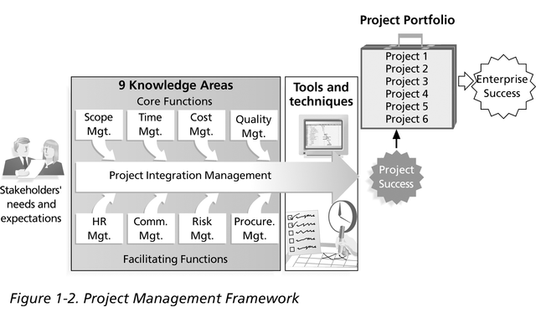
PM Framework , cont’

Slide 14
Project Stakeholders
PM Framework
Stakeholders are the people involved in or affected by project activities
Stakeholders include
the project sponsor and project team
support staff
customers
users
suppliers
opponents to the project

Slide 15
PM knowledge areas
PM knowledge areas describe the key competencies that project managers must develop:
Scope
Time
Cost
quality
human resources
Communication
Risk
procurement management
project integration management
PM Framework
4 core knowledge areas lead to specific project objectives
4 facilitating knowledge areas are the means through which the project objectives are achieved
affects and is affected by all of the other knowledge areas

